Slide 1
Bitmap Font / Graphics

Slide 2
Bitmap Text /Image
The most common and comprehensive form of storage for images on a computer is a raster or bitmap image. Bitmap is a simple matrix of the tiny dots called pixel that forms a raster or bitmap image (Vaughan, 2008). Each pixel consists of two or more colours. The colour depth is determined by how much data, in bits is used to determine the number of colours e.g. one bit is two colours, four bits means sixteen colours, eight bits indicates 256 colours, 16 bits yields 65,536 colours and so on. Depending on the hardware capabilities, each point can display from two to millions of colours. Comprehensive image means that an image looks as much as possible like the real word or original product. This means that the proportion, size, colour, and texture must be as accurate as possible. Bitmap formats are Windows Bitmap (BMP), Device Independent Bitmap (DIB), and Windows Run Length Encoded (RLE) (Hillman, 1998). (ii) Vector Image

Slide 3
Bitmap Image
A bitmap font is basically a 2D font. Although we’ll place it in a 3D world, these fonts will have no thickness and can’t be rotated or scaled, only translated. Furthermore, the font will always face the viewer, like a billboard. Although this can be seen as a potential disadvantage, on the other hand we won’t have to worry about orienting the font to face the viewer
In this section we’ll present the GLUT functions to put some bitmapped text on the screen. We’re going to need one function to write a char: glutBitmapCharacter. The syntax is as follows:

Slide 4
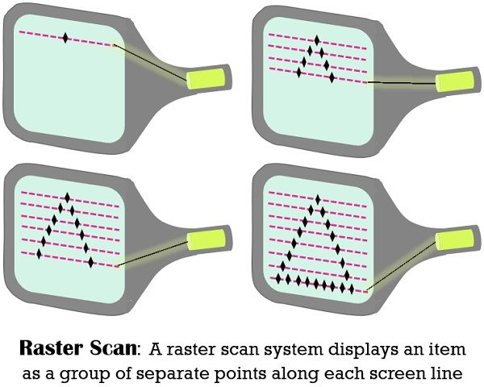

Slide 5
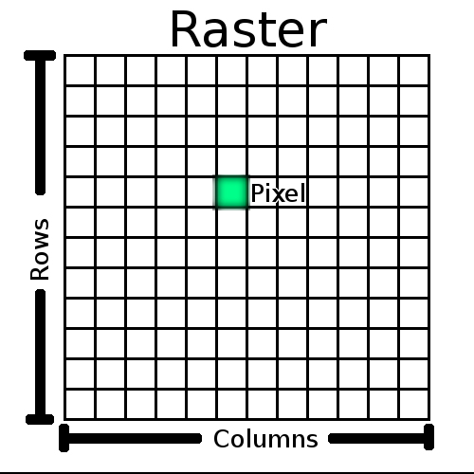

Slide 6
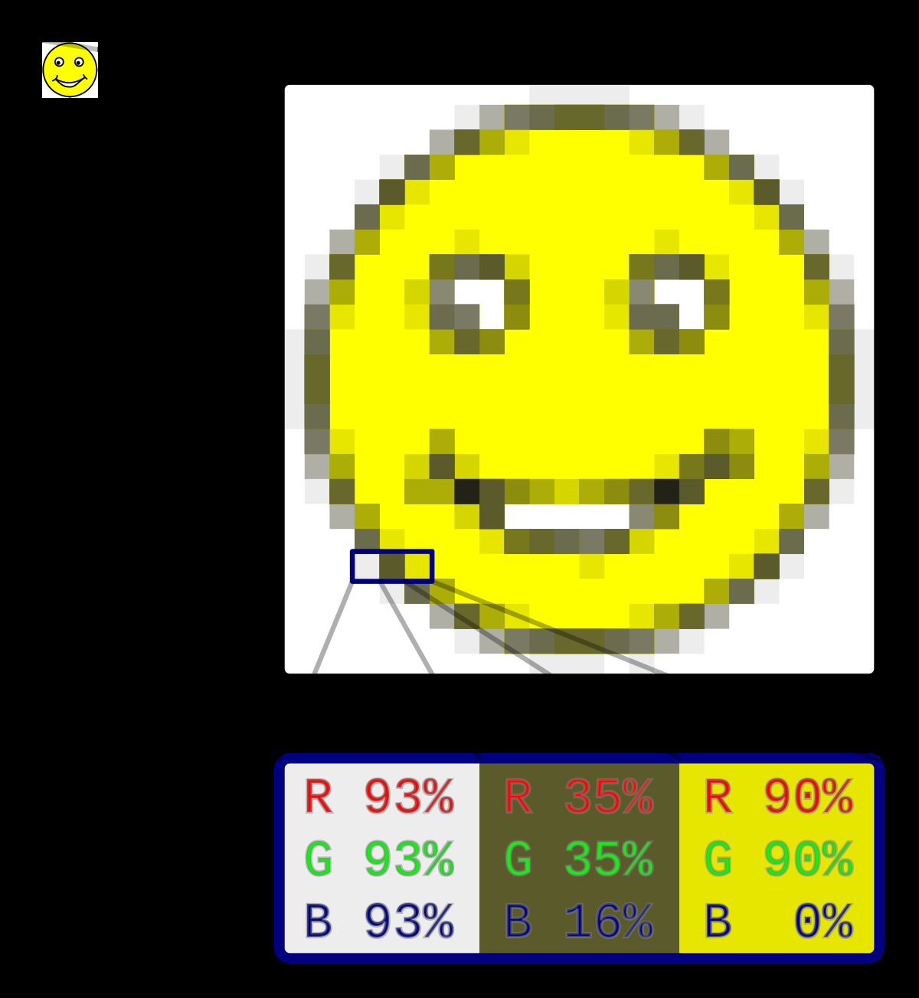

Slide 7
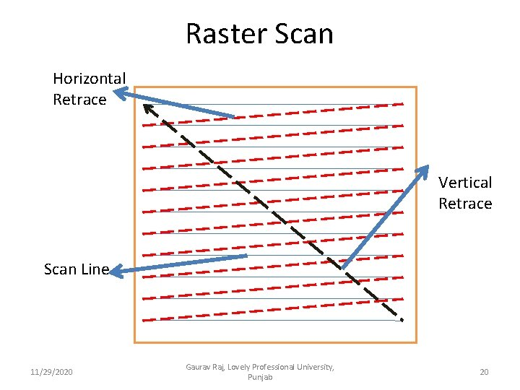

Slide 8
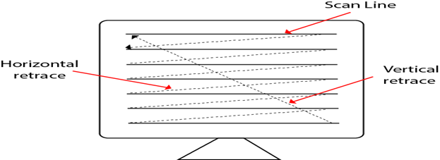

Slide 9
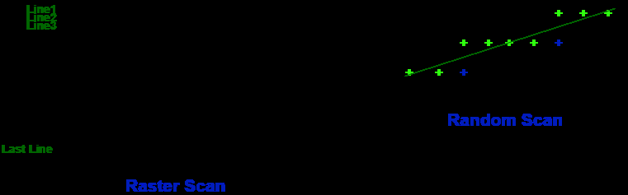

Slide 10
Bitmap Image
void glutBitmapCharacter(void *font, int character)
Parameters:
font – the name of the font to use (see bellow for a list of what’s available
character – what to render, a letter, symbol, number, etc…

Slide 11
Bitmap Image
The font options available are:
GLUT_BITMAP_8_BY_13
GLUT_BITMAP_9_BY_15
GLUT_BITMAP_TIMES_ROMAN_10
GLUT_BITMAP_TIMES_ROMAN_24
GLUT_BITMAP_HELVETICA_10
GLUT_BITMAP_HELVETICA_12
GLUT_BITMAP_HELVETICA_18

Slide 12
glutBitmapCharacter
glutBitmapCharacter renders a bitmap character using OpenGL.
Usage
void glutBitmapCharacter(void *font, int character); fontBitmap font to use.characterCharacter to render (not confined to 8 bits).
Description
Without using any display lists, glutBitmapCharacter renders the character in the named bitmap font. The available fonts are:
GLUT_BITMAP_8_BY_13A fixed width font with every character fitting in an 8 by 13 pixel rectangle. The exact bitmaps to be used
is defined by the standard X glyph bitmaps for the X font named:-misc-fixed-medium-r-normal--13-120-75-75-C-80-iso8859-1
GLUT_BITMAP_9_BY_15A fixed width font with every character fitting in an 9 by 15 pixel rectangle. The exact bitmaps to be used
is defined by the standard X glyph bitmaps for the X font named:-misc-fixed-medium-r-normal--15-140-75-75-C-90-iso8859-1
GLUT_BITMAP_TIMES_ROMAN_10A 10-point proportional spaced Times Roman font. The exact bitmaps to be used is defined by
the standard X glyph bitmaps for the X font named:-adobe-times-medium-r-normal--10-100-75-75-p-54-iso8859-1
GLUT_BITMAP_TIMES_ROMAN_24A 24-point proportional spaced Times Roman font. The exact bitmaps to be used is defined by
the standard X glyph bitmaps for the X font named:-adobe-times-medium-r-normal--24-240-75-75-p-124-iso8859-1
GLUT_BITMAP_HELVETICA_10A 10-point proportional spaced Helvetica font. The exact bitmaps to be used is defined by the
standard X glyph bitmaps for the X font named:-adobe-helvetica-medium-r-normal--10-100-75-75-p-56-iso8859-1
GLUT_BITMAP_HELVETICA_12A 12-point proportional spaced Helvetica font. The exact bitmaps to be used is defined by the
standard X glyph bitmaps for the X font named:-adobe-helvetica-medium-r-normal--12-120-75-75-p-67-iso8859-1
GLUT_BITMAP_HELVETICA_18A 18-point proportional spaced Helvetica font. The exact bitmaps to be used is defined by the
standard X glyph bitmaps for the X font named:-adobe-helvetica-medium-r-normal--18-180-75-75-p-98-iso8859-1

Slide 13
Bitmap Image
Some of the font names are recognizable so you’ll probably know what to expect, nevertheless you’ll have the opportunity of trying all fonts in the example application via a pop-up menu.
The following line of text exemplifies a call to the glutBitmapCharacter function to output a single character at the current raster position:
glutBitmapCharacter(GLUT_BITMAP_HELVETICA_18,'3');

Slide 14
Reference and text books:-
TEXT BOOKS
Tay Vaughan, “Multimedia making it work”, Tata McGraw-Hill, 2008.
Rajneesh Aggarwal & B. B Tiwari, “Multimedia Systems”, Excel Publication, New Delhi, 2007.
Li & Drew, “Fundamentals of Multimedia”, Pearson Education, 2009.
REFERENCE BOOKS
Parekh Ranjan, “Principles of Multimedia”, Tata McGraw-Hill, 2007
Anirban Mukhopadhyay and Arup Chattopadhyay, “Introduction to Computer Graphics and Multimedia”, Second Edition, Vikas Publishing House.

Slide 15
Any query ??

Slide 16

Thank you

